Slide 1


Processing FY3D Data in CSPP LEO CLAVR-x
Yue Li, Steve Wanzong,
Andi Walther, Denis Botambekov,
William Straka
UW/SSEC/CIMSS, Madison, WI, USA
Andrew Heidinger
NOAA/NESDIS/STAR Madison, WI, USA

Slide 2
Outline
Introduction to CSPP LEO CLAVR-x
Implementation of FY-3D into CLAVR-x
Example Products from FY-3D
Comparison of FY-3D to NOAA-20 JPSS and Suomi-NPP VIIRS
Comparison of FY-3D to FY-4A and other Asian Geo Imagers
Current CLAVR-x Development Activities
How to Access CSPP LEO CLAVR-x
Conclusions

Slide 3
Introduction to CLAVR-x
CLAVR-x is NOAA’s cloud processing system for the NOAA POES and GOES-11/12/13 for 20 years.
CLAVR-x is the processing system of the PATMOS-x climate data record, currently being stored at NCEI.
CLAVR-x has been an integral part of the CSPP system for several years in order to provide products in a quick manner utilizing data from Direct Broadcast.
CLAVR-x runs the NOAA Enterprise Cloud Algorithms on LEO and GEO. It complements the official NESDIS software which will be available from CSPP but only supports VIIRS.
CLAVR-x is now developed at SSEC/CIMSS, CSU/CIRA and NOAA/NESDIS.
This work is supported by NOAA JPSS Funding.

Slide 4
Current Sensors Supported by CSPP LEO CLAVR-x
NOAA POES AVHRR on NOAA-15, 18, 19
VIIRS on NOAA-20 and SUOMI-NPP
EUMETSAT METOP AVHRR on METOP-A, B & C
NASA AQUA and TERRA MODIS
CMA FY3D MERSI-2 (Coming)
EUMETSAT EPS-SG MetImage (Planned)
With little adjustment CSPP-LEO, CLAVR-x also supports:
NOAA GOES-16 and GOES-17 ABI
NOAA GOES-8-15 GVAR
JMA HIMAWARI-8 and HIMAWARI-9 AHI
KMA COMS MI
EUMETSAT METEOSAT-8, 9, 10, 11 SEVIRI
CMA FY-4A AGRI (Coming)
KMA GEO-KOMPSAT-2A AMI (Planned)

Slide 5
What does CLAVR-x provide
All Underlined product algorithms are adopted as NOAA’s operational algorithm for VIIRS on SNPP/NOAA-20 and ABI on GOES-16/17
Cloud Mask: A Naive Bayesian approach.
Cloud Type/Phase: Based on spectral tests.
Cloud Top Temperature/Height/Pressure (ACHA): An optimal estimation based approach.
Daytime Cloud Optical and Microphysical Properties (DCOMP): An optimal estimation based approach.
Nighttime Lunar Cloud Optical and Microphysical Properties (NLCOMP): Utilize lunar reflectance and a lunar reflectance model.
Cloud Base Height: A statistically based approach.
Cloud Cover Layer (CCL): Compute cloud fraction at various flight levels and resolution using cloud mask and ACHA products.
And many more ...

Slide 6
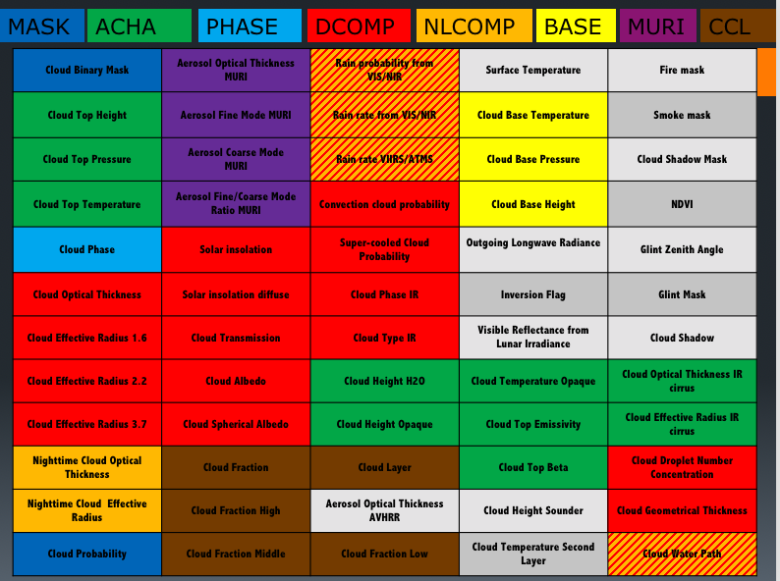
Break-down of CLAVR-x products by Algorithm

Slide 7
What’s New in CLAVR-x
CLAVR-x can now make NETCDF4 output.
Level-2 selection is now accomplished at run-time and changes to Level-2 contents do not require recompilation.
If users wish to configure the output of their Level-2 fields, this can now be done via a configuration file at run-time.
We use precomputed navigation files for fixed-grid geo stationary imagers - this speeds up processing.
CLAVR-x also allows for an arbitrary processing box to be defined for fixed-grid geostationary imagers using lat/lon limits.
HIMAWARI-8 AHI data native HSD data is now supported as well as NetCDF.

Slide 8
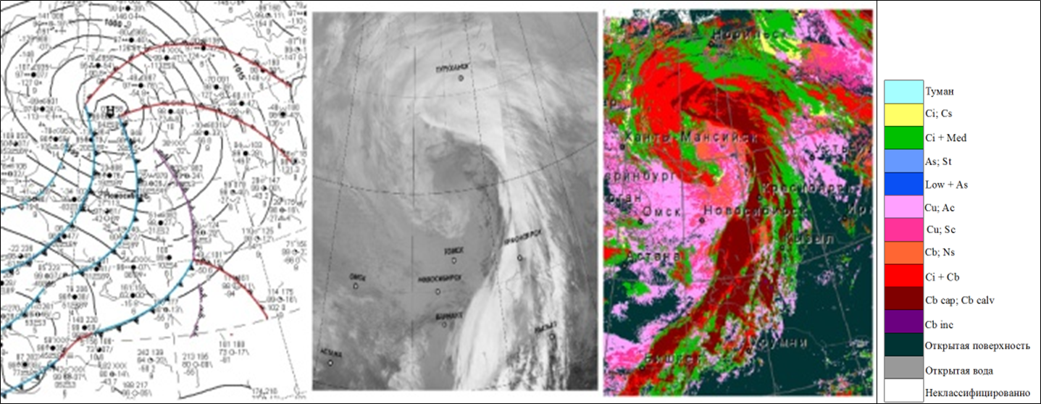
Applications of CSPP LEO CLAVR-x (Russia)
Russian Federation’s State Research Center "Planeta“ in Novosibirsk and Khabarovsk are using CSPP LEO CLAVR-x operationally.
They take CLAVR-x products and create WMO Cloud Classifications (example shown below).
CLAVR-x output provides many level-1b values, ancillary data and facilitates generation of new value-added products for specific customers.
WMO Cloud Classification from AVHRR NOAA-19, 2016-09-04, 07:04 UTC
Surface Analysis Map 2016-09-04 06:00 UTC
11um BT.

Slide 9
Implementation of FY3D/MERSI-2
into CLAVR-x

Slide 10
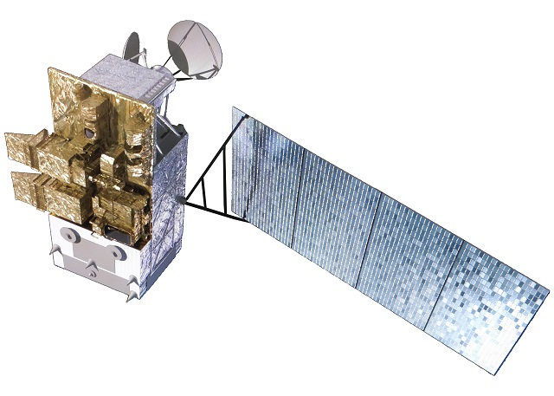
MERSI-2 on FY3D
MERSI-2 is the imager on FY3D, which is the latest Chinese LEO satellite.
MERSI-2 has 25 bands that cover from shortwave reflectance to longwave infrared bands.
24 out of the 25 bands that are similar to MODIS, except 0.71um (Ch13), are read into CLAVR-x.
CMA provides data that is aggregated to 1km for the high resolution channels.
Image courtesy of NSMC

Slide 11
MERSI-2 on FY3D - CLAVR-x Channel list
11 | 0.555 | 1.0
12 | 0.670 | 1.0
14 | 0.746 | 1.0
15 | 0.865 | 1.0
16 | 0.905 | 1.0
17 | 0.936 | 1.0
18 | 0.940 | 1.0
19 | 1.03 | 1.0
20 | 3.8 | 1.0 | Mask, Type, DCOMP
21 | 4.05 | 1.0 | Mask
22 | 7.2 | 1.0
23 | 8.55 | 1.0 | Mask, Type,ACHA
24 | 10.8* | 0.250 | Mask, Type,ACHA
25 | 12.0* | 0.250 | Mask, Type,ACHA
MERSI-2 chan # number | Wavelength (μm) | Native Res. (km) | Which algorithms use channel
1 | 0.470 * | 0.250
2 | 0.550* | 0.250
3 | 0.650* | 0.250 | Mask, DCOMP, Solar Radiation
4 | 0.865* | 0.250 | Mask, Aerosols
5 | 1.38 | 1.0 | Mask
6 | 1.64 | 1.0 | Mask, Type, DCOMP
7 | 2.13 | 1.0 | Mask, DCOMP
8 | 0.412 | 1.0 | Mask
9 | 0.443 | 1.0
10 | 0.490 | 1.0
* The MERSI-II aggregated file only provides the 1km radiances

Slide 12
Example FY3D/MERSI-2
CLAVR-x Products and Imagery

Slide 13
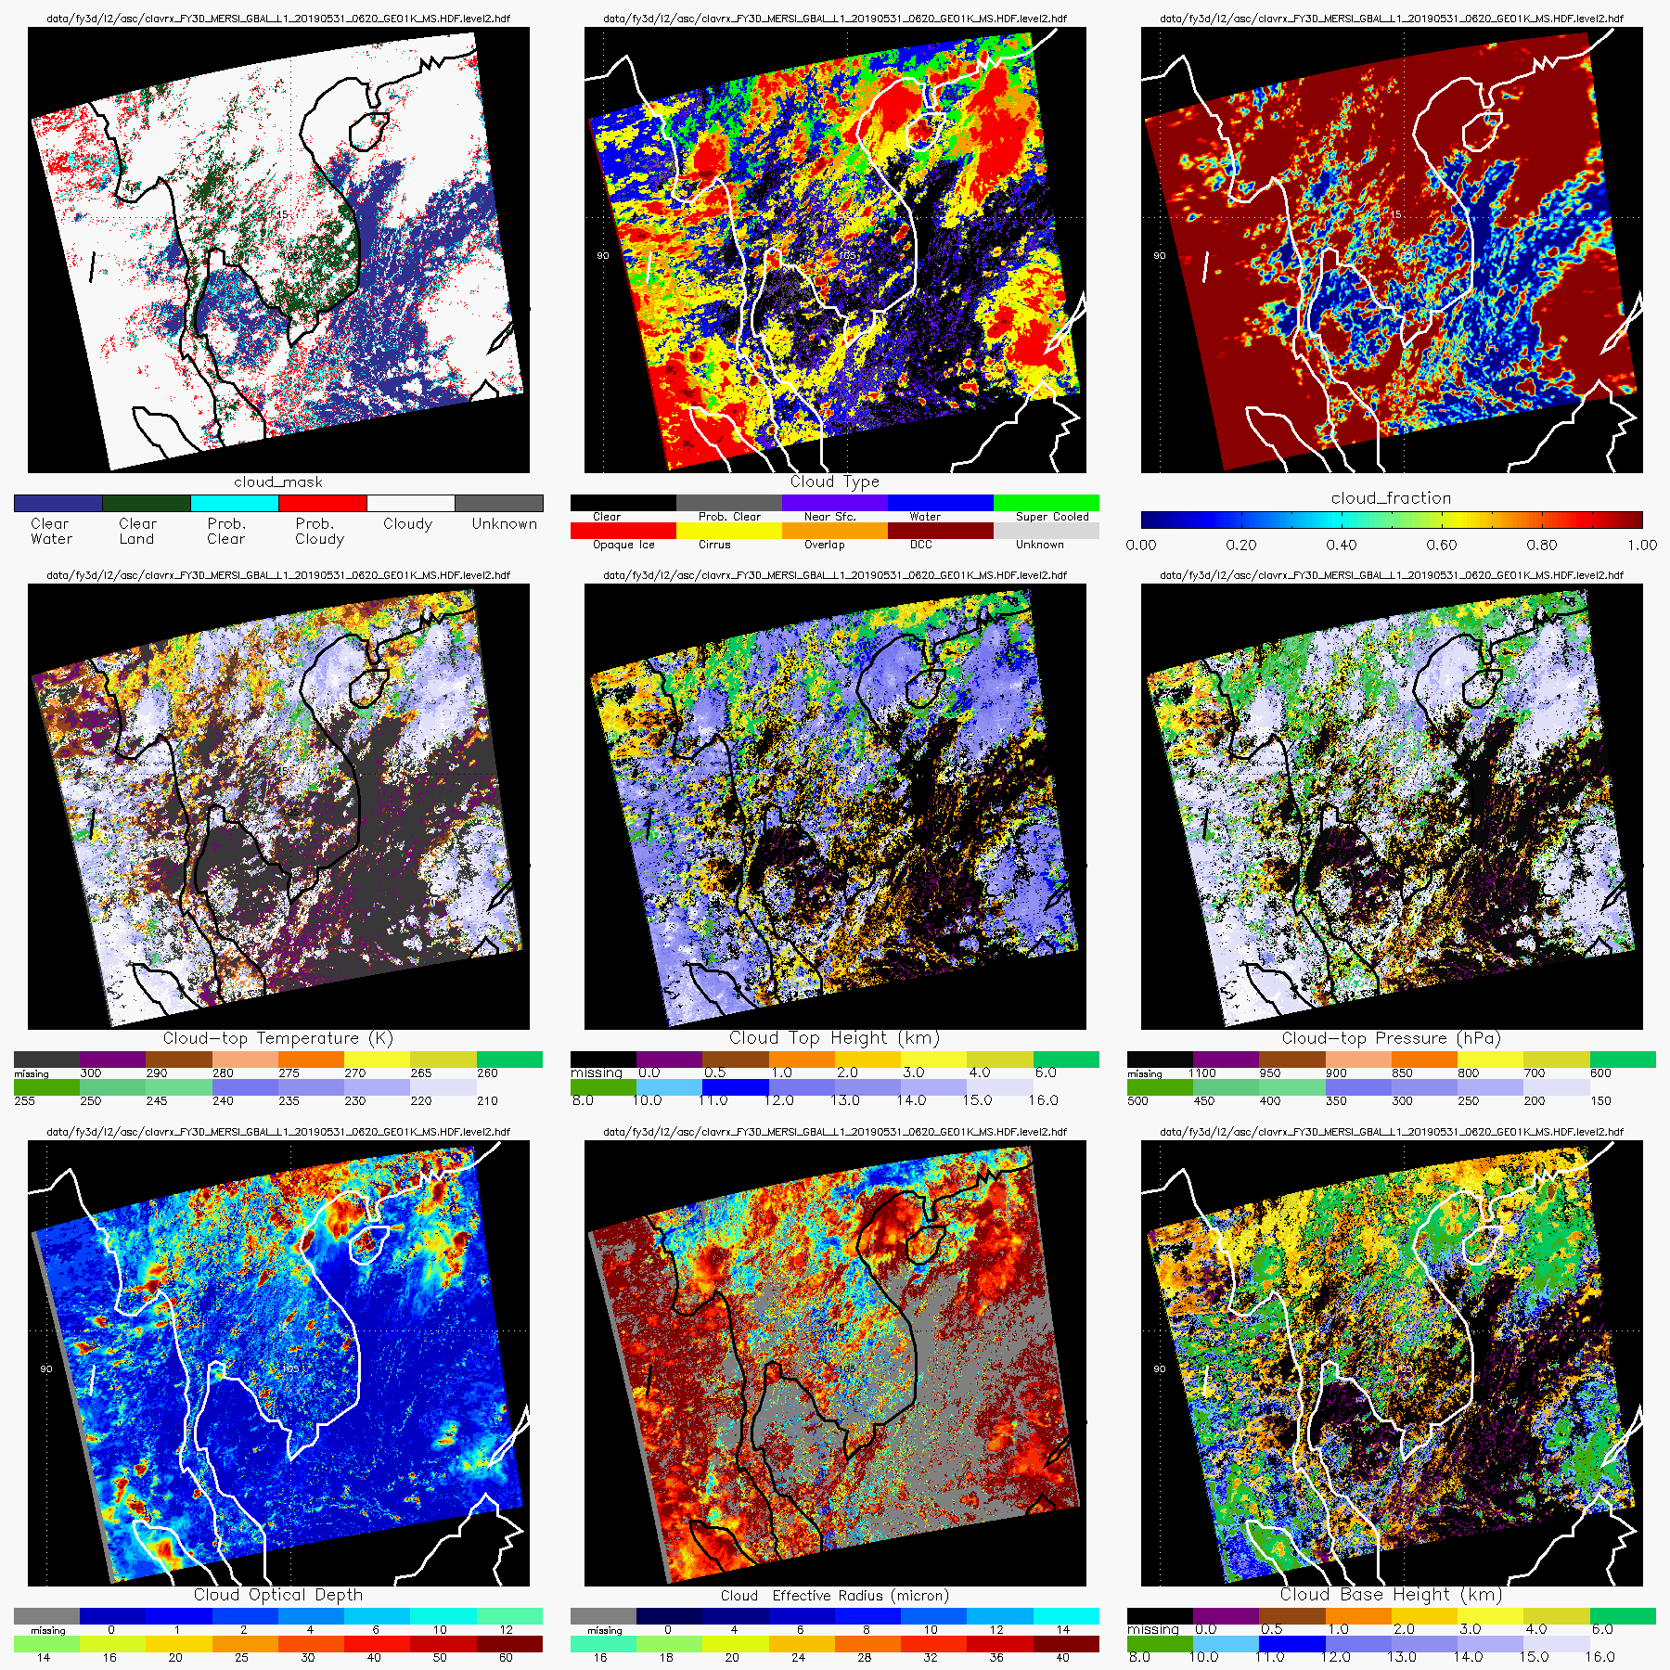
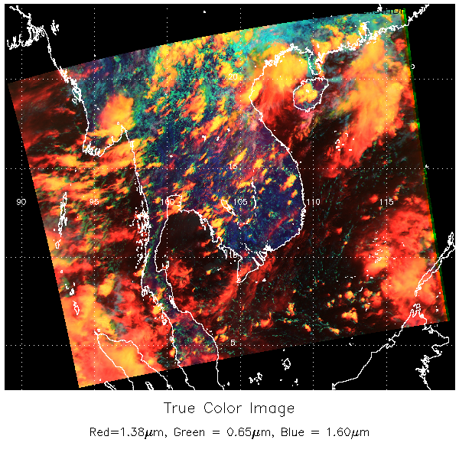
Example FY3D level2 products from 05/31/2019 at 0620 UTC from CLAVR-x showing:
Cloud mask, type and fraction.
Cloud temperature, height and pressure.
Cloud optical depth, size and cloud base height.
Cloud Mask
Cloud Type
Cloud Fraction
Cloud Temp.
Cloud Height
Cloud Pressure
Cloud Opt. Depth
Cloud Eff. Radius
Cloud Base Height
Red - Cirrus;
Yellow - Thick Ice; Turquoise - Water
Notes:
Point out the failed detector along the edge, which affects all products particularly cloud mask and type.

Slide 14
Comparison of FY3D/MERSI-2 to NOAA-20/SNPP VIIRS

Slide 15
Comparison/Validation
Official FY3D MERSI-2 cloud products are NOT yet available for public access.
FY3D CLAVR-x retrievals are compared to VIIRS onboard NOAA-20 and Suomi-NPP.
SNPP ahead of NOAA-20 by 50 minutes.
FY3D ahead of NOAA-20 by about 12 minutes.

Slide 16
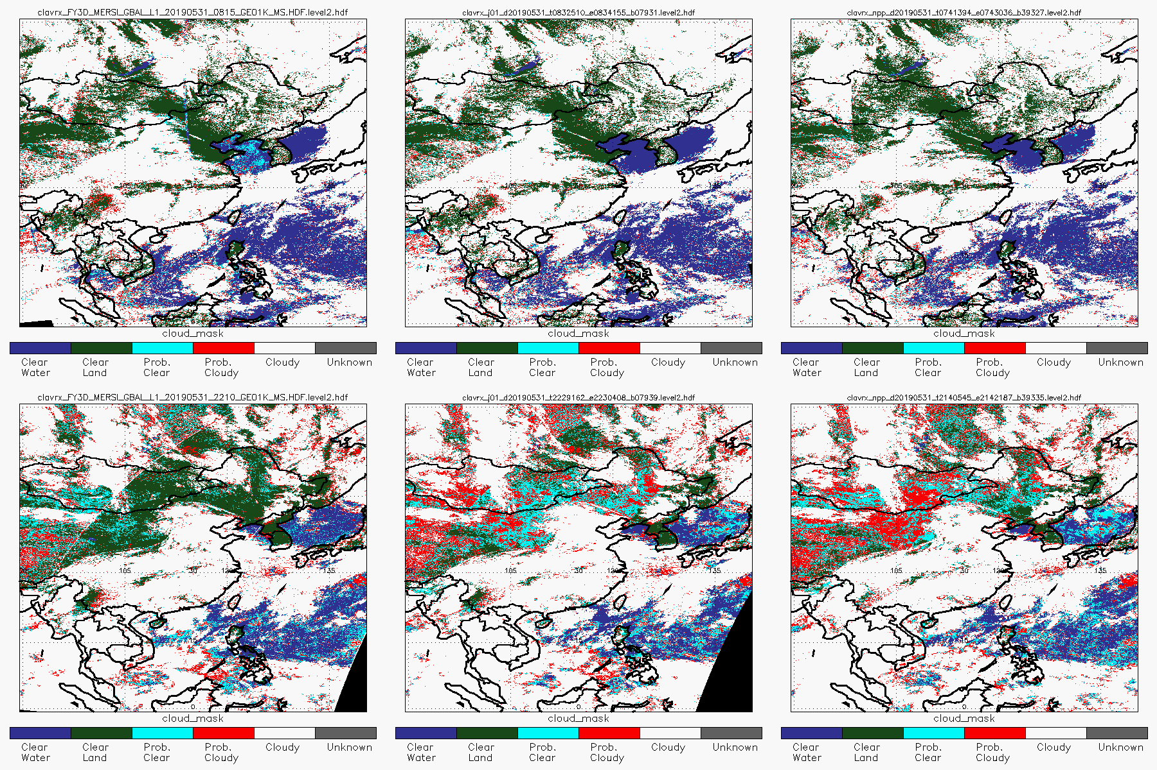
Cloud Mask
FY3D
NOAA-20
SNPP
Ascending
Cloud Mask differences
Descending
ECM results from FY3D use a LUT derived from MODIS. Data from SNPP and NOAA-20 use the the LUT from the NOAA operational processing string.
Notes:
There are some differences in the Cloud Mask performance. The reason of this likely due to the use of LUT. To make an original Cloud Mask LUT for the sensor, it requires about 1 year of CALIPSO/CALIOIP collocation data. In this example for FY3D we used MODIS LUT, and differences are expected.

Slide 17
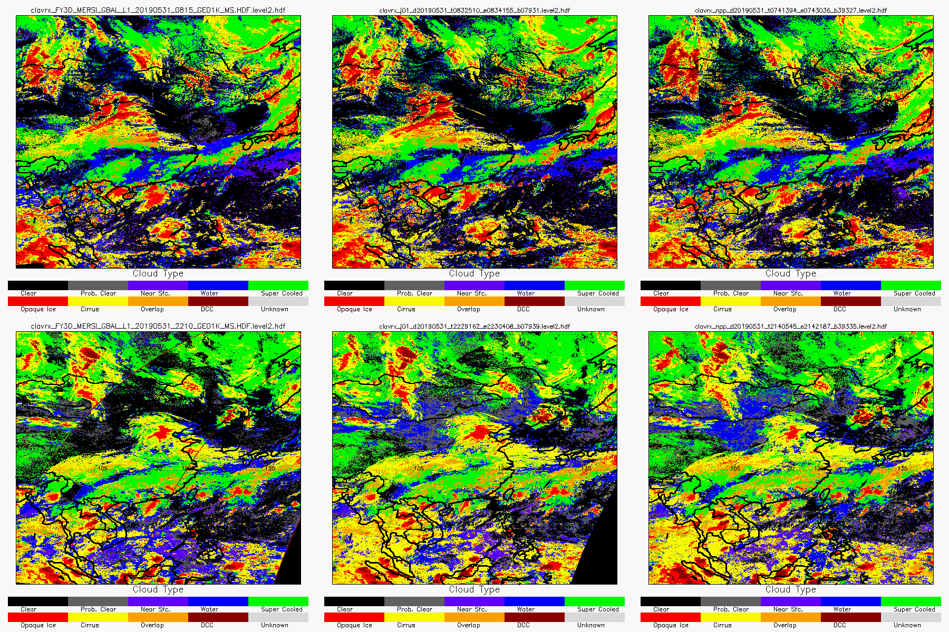
Cloud Type
FY3D
NOAA-20
SNPP
Ascending
Descending
Cloud mask difference affects cloud type retrieval coverage
FY3D tends to retrieve less ice clouds

Slide 18
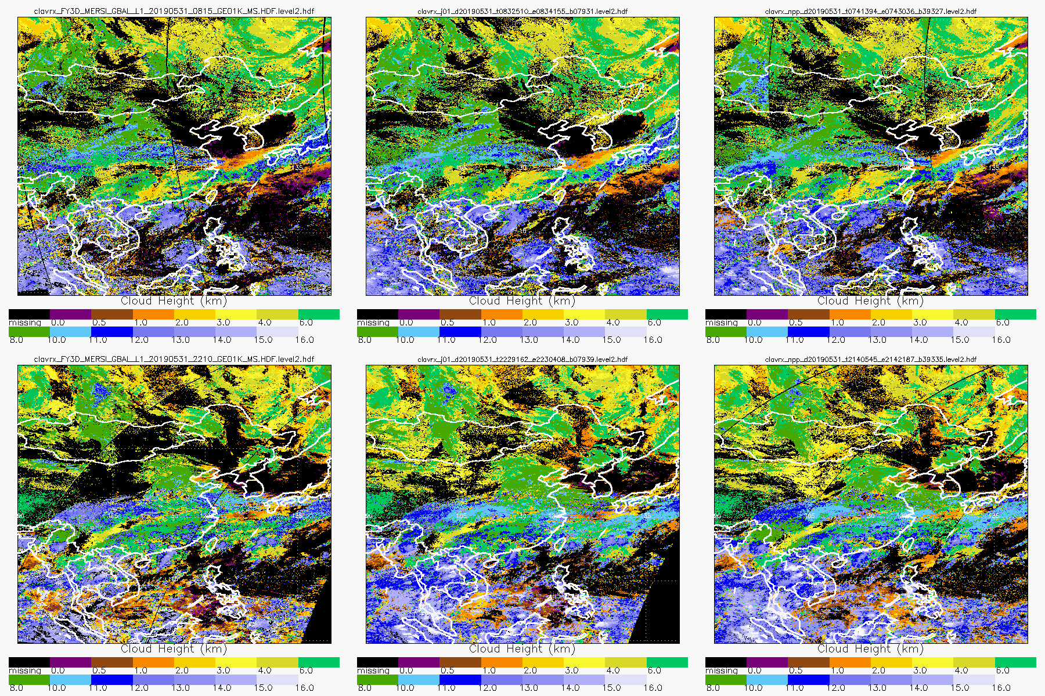
Cloud Top Height
FY3D
NOAA-20
SNPP
Ascending
Descending
As cloud top height retrieval is dependant on cloud type, differences are observed

Slide 19
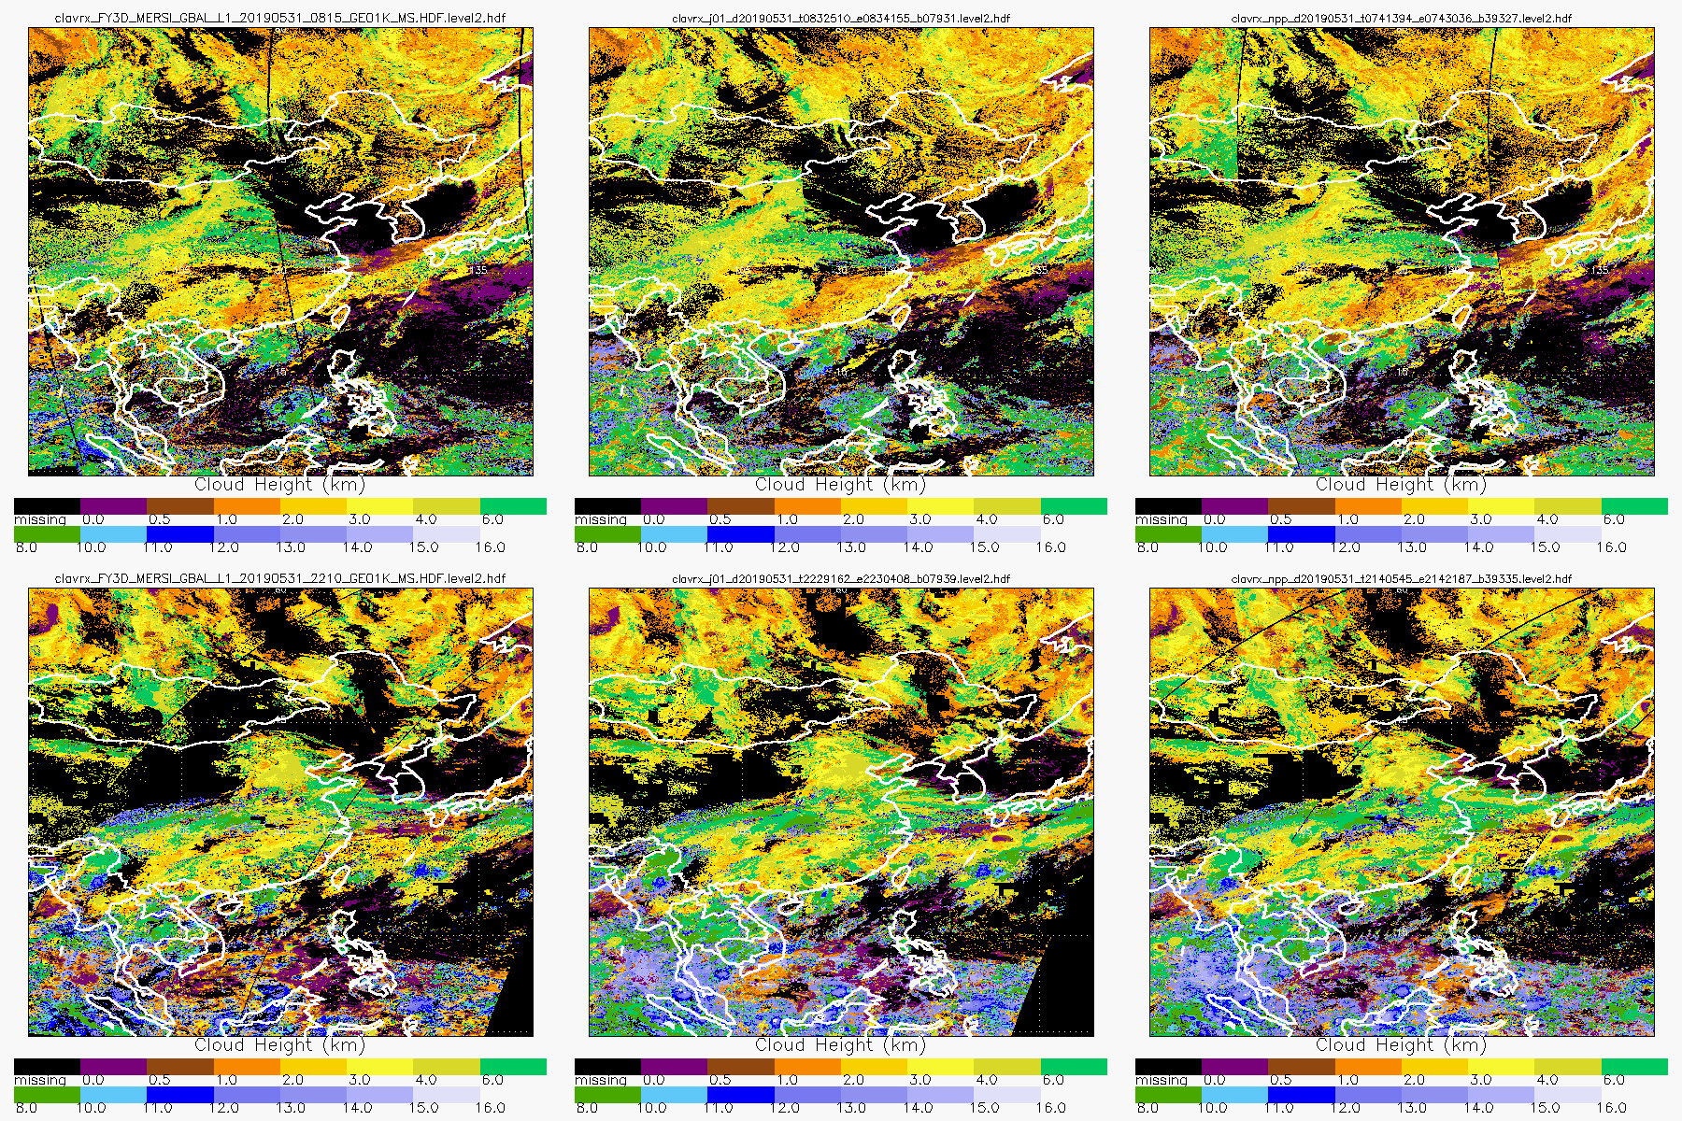
Cloud Base Height
FY3D
NOAA-20
SNPP
Ascending
Descending
Retrieval of cloud base height utilizes cloud top height.

Slide 20
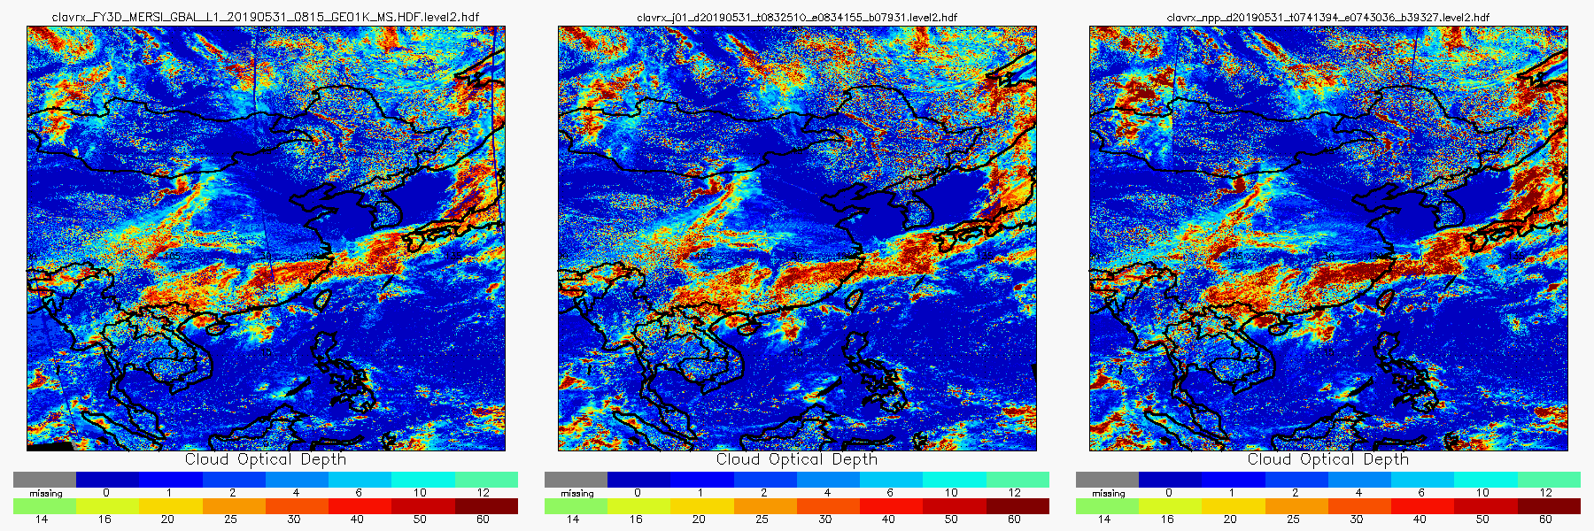
Daytime Cloud Optical Depth
FY3D
NOAA-20
SNPP
COD show good agreement among the sensors.

Slide 21
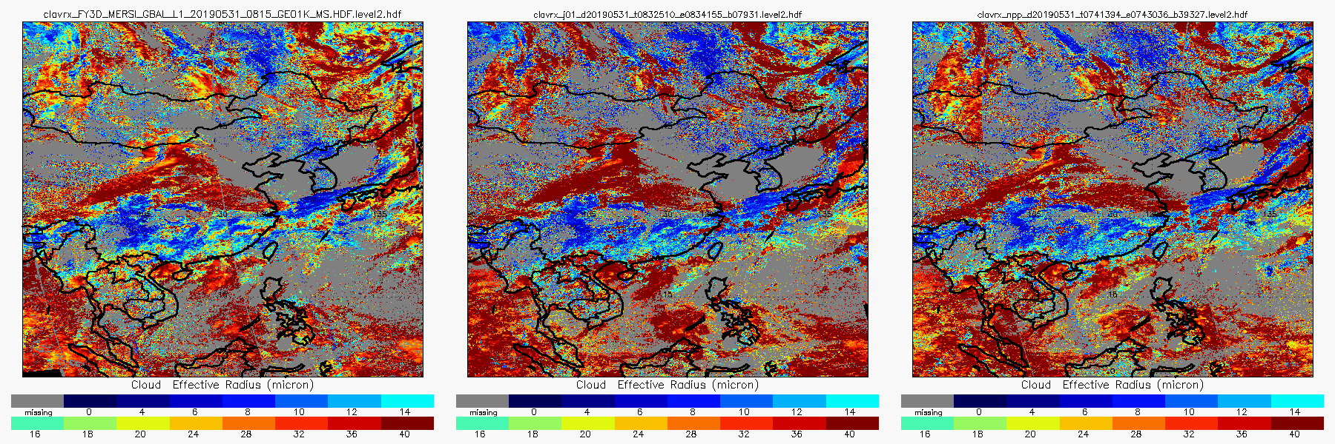
Daytime Cloud Effective Particle Size
FY3D
NOAA-20
SNPP
Effective Radius show good agreement among the sensors.

Slide 22
Summary of FY3D Comparison to JPSS/SNPP VIIRS
FY3D compares reasonably well with both NOAA-20 and SNPP.
Better consistency is observed between NOAA-20 and SNPP due to similar sensors.
Major cloud mask differences during nighttime may be caused by the use of different LUTs.
FY3D retrievals tend to show less ice clouds, which affects other downstream cloud products.

Slide 23
Comparison of FY3D/MERSI-2 to FY4A/AGRI, COMS/MI, METEOSAT-8/SEVIRI and HIMAWARI-8/AHI

Slide 24
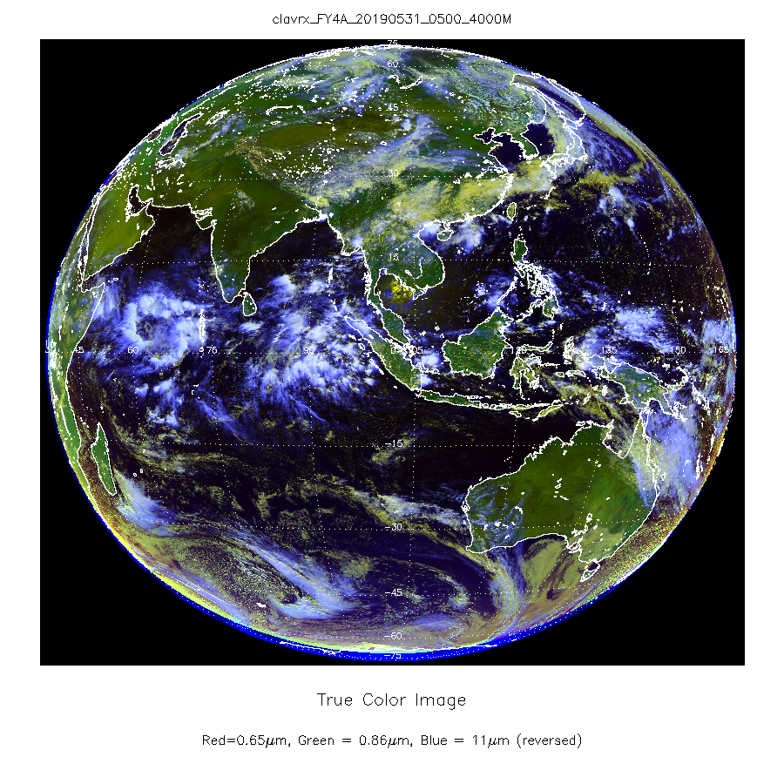
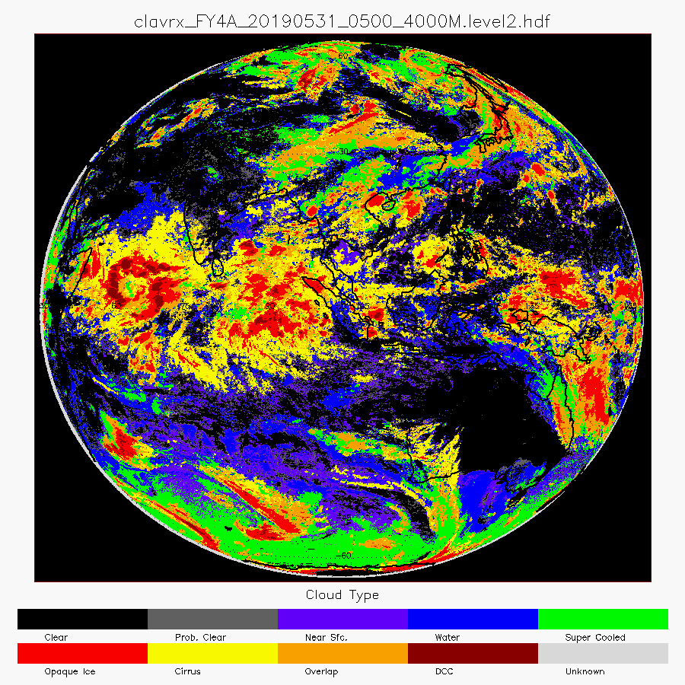
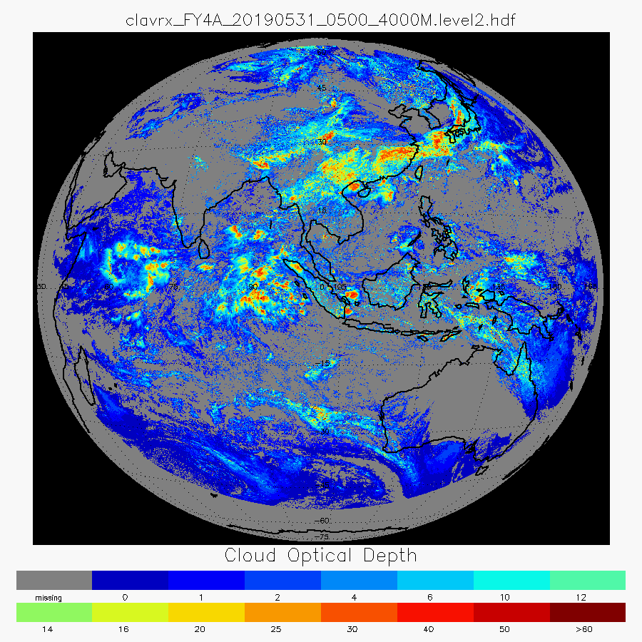
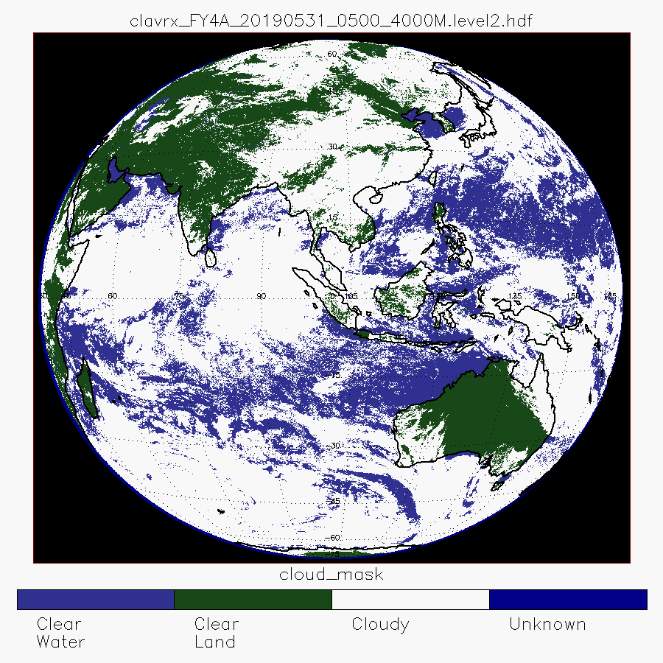
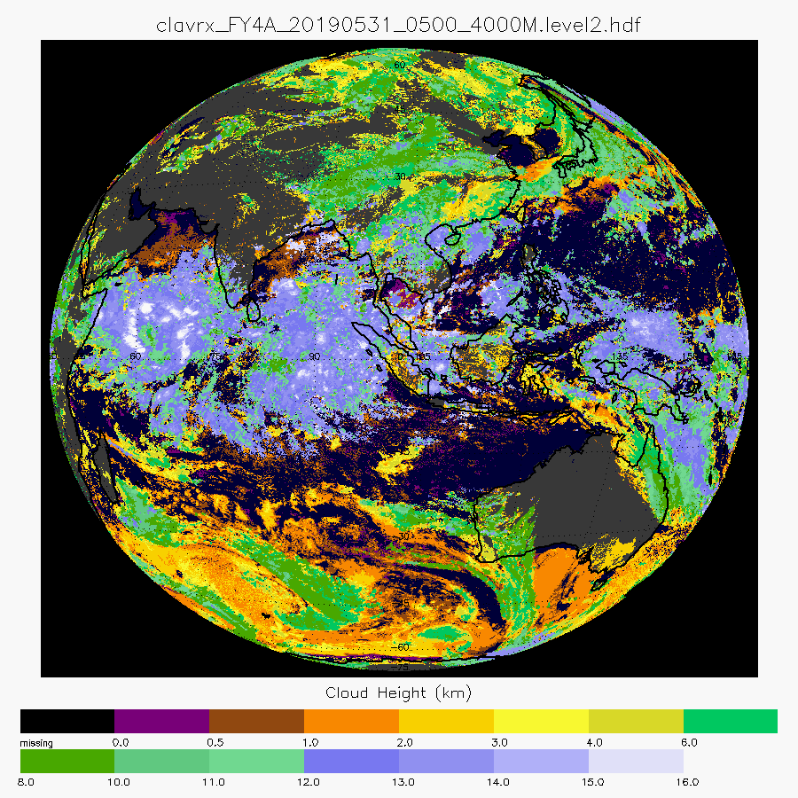
FY-4A in CLAVR-x
Check out Poster # 2. Denis Botambekov
Cloud Type
Cloud Optical Depth
RGB
FY-4A is added to the CLAVR-x.
It is uses Static Navigation Info.
Processes 4km FD data.
Cloud Mask
Cloud
Top Height
AGRI, FY-4A, May 31, 2019, 0500 UTC
Notes:
Level1b data were obtained from CMA Data Center. We appreciate it very much.
FY-4A is also added to the CLAVR-x. My colleague - Denis Botambekov has a poster about this. It is # 2.
Because the grid is fixed Latitude/Longitude, Viewing and Solar angles are calculated. This significantly reduces the processing speed.
For now CLAVR-x processes only Full Disk 4km FY-4A observation data.

Slide 25
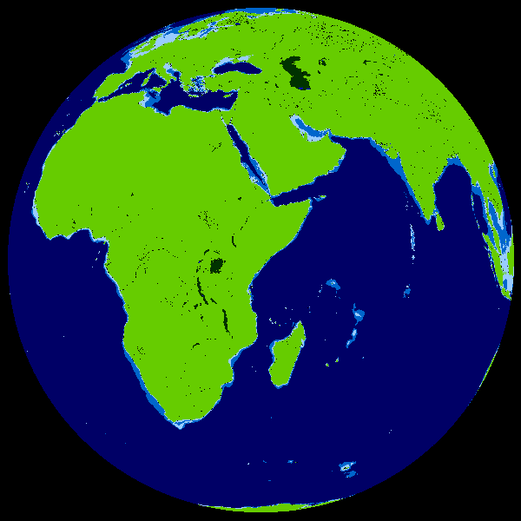
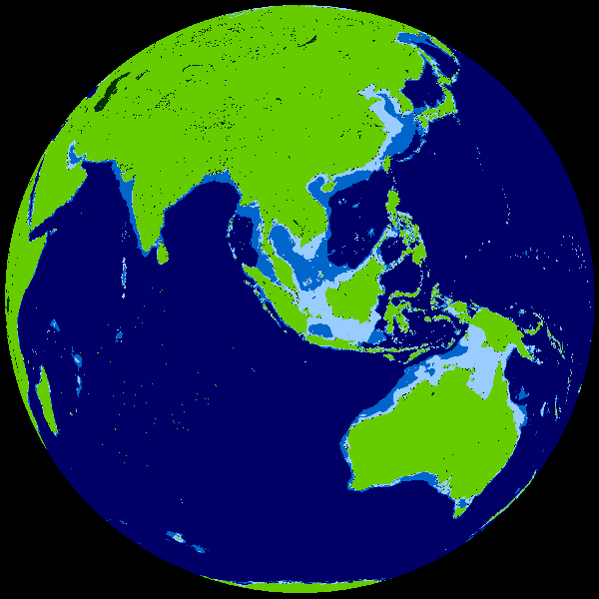
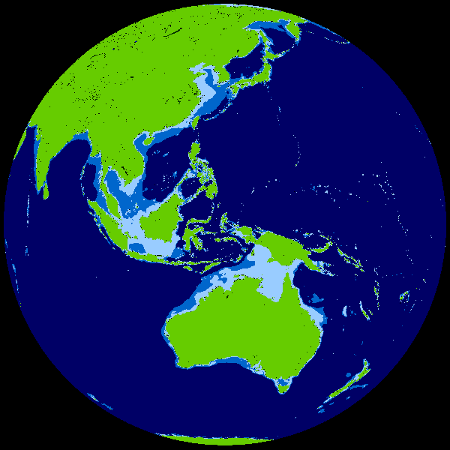
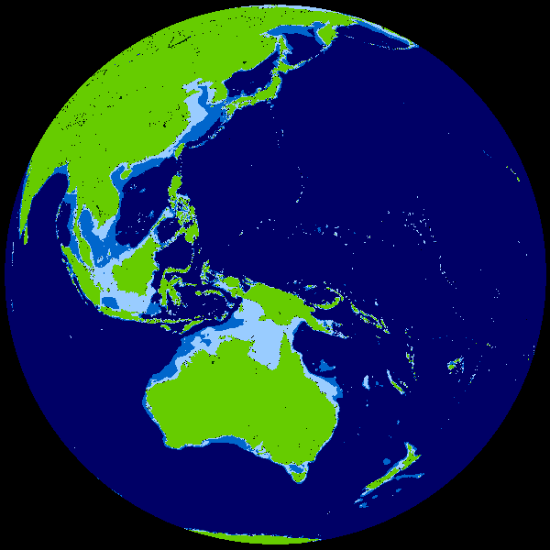
Comparing FY3D to Asian Geostationary Imagers
CLAVR-x can process most current geostationary imagers including: MET8/SEVIRI, FY4A/AGRI, COMS/MI and HIM8/AHI.
This allows FY3D to be simultaneously compared to multiple geo imagers at once.
Following slides show analysis of FY3D data over the China Region on May 31, 2019 06:15 to 06:25 UTC.
Note, the MET8 viewing angles are large for this comparison.
MET8
FY4A
COMS
HIM8

Slide 26
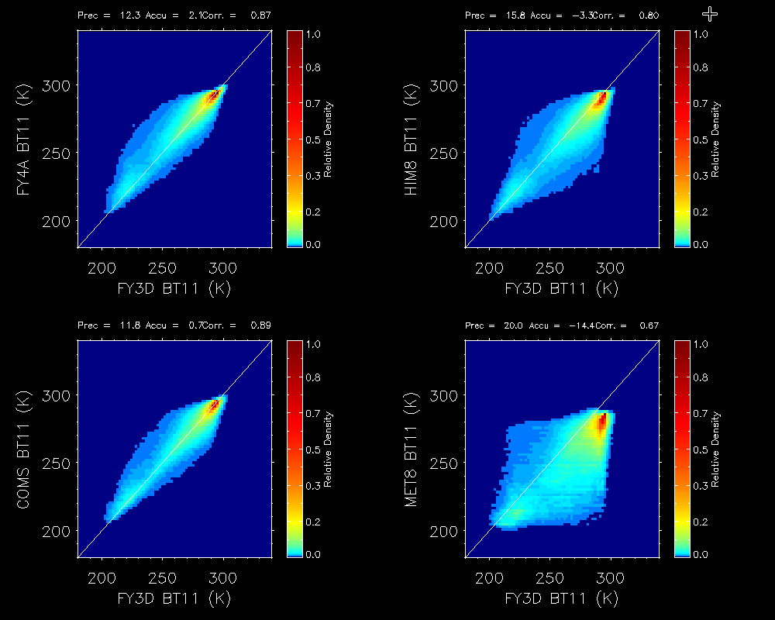
Comparison of 11 micron Brightness Temperature
CLAVR-x uses the nominal calibration information within the level-1b data.
It does its own internal radiance to temperature conversion.
Comparison of the BT11 values from each sensor shows good agreement and no evidence of scene temperature dependent bias.
MET8 values have a higher scatter due to the severe viewing angles.
No spectral adjustment was done here and its assumed to be negligible for these window channels.
FY4A
HIM8
COMS
MET8

Slide 27
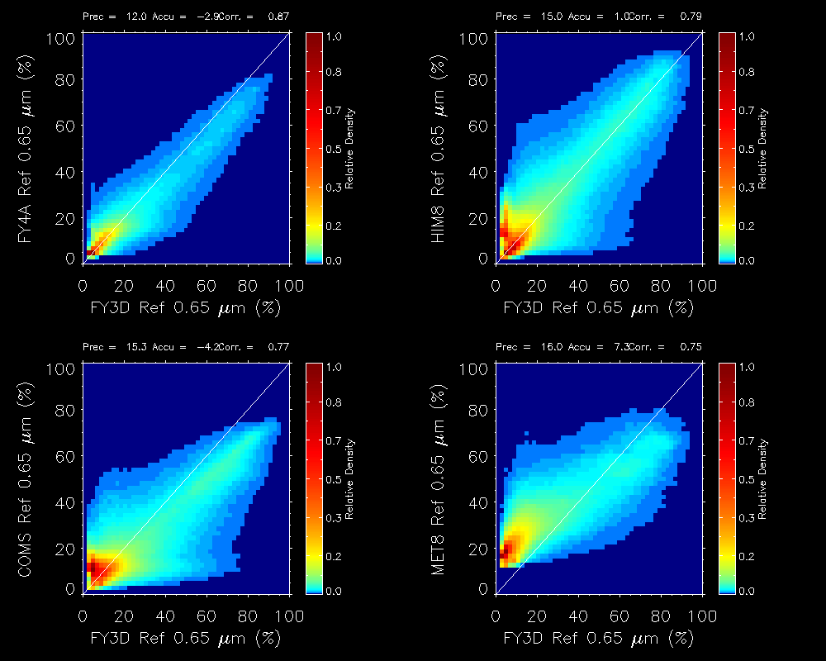
Comparison of 0.65 micron Reflectance
As with the thermal calibration, CLAVR-x applies the solar reflectance calibration from the level-1b.
All sensors except COMS have an on-board calibration system.
Comparison is very good overall and FY3D agrees best with HIM8/AHI.
Its appears FY3D is slightly brighter than COMS and FY4A.
MET8 signal has much more atmospheric scattering and should be ignored.
FY4A
HIM8
COMS
MET8

Slide 28
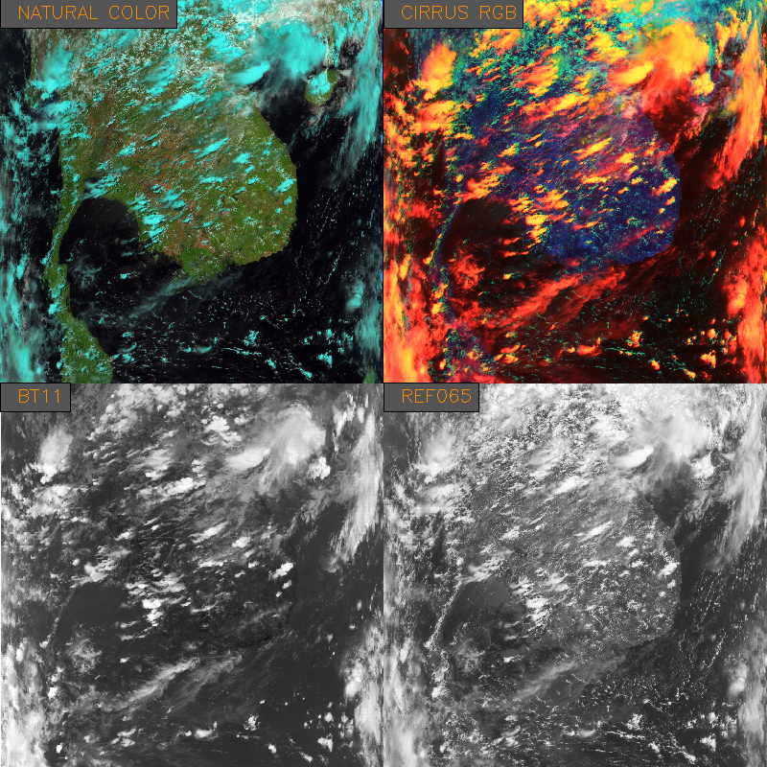
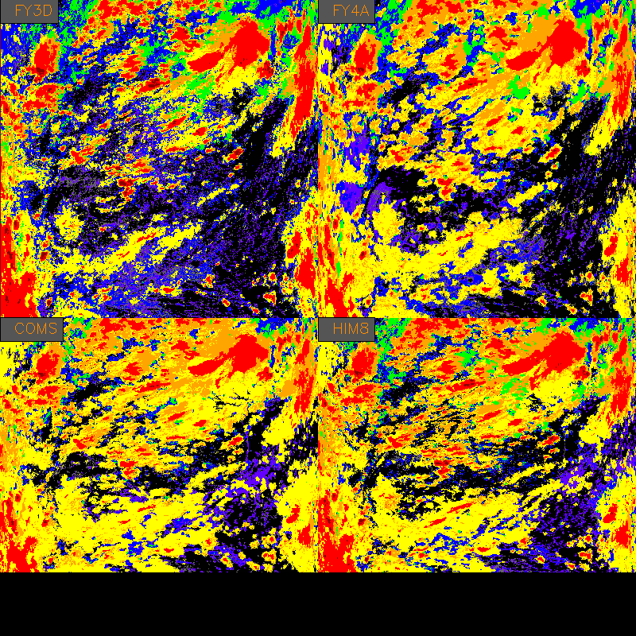

Comparison of Cloud Type
For a reason yet unknown, the CLAVR-x type on FY3D seems to under-detect cirrus relative to the geostationary imagers

Slide 29
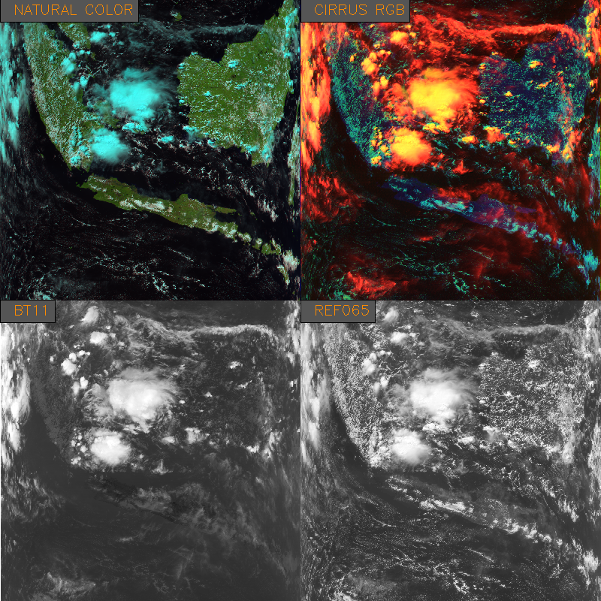
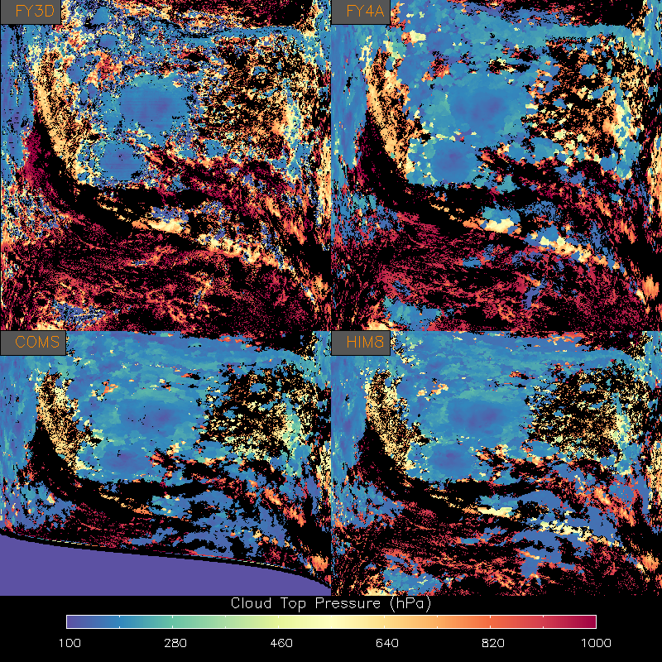
Comparison of Cloud Top Pressure
no data
Cloud Top Pressures - which use water vapor, window and CO₂ channels (when available) seem to agree well.
Aforementioned issue with cloud type impacts cloud top pressure

Slide 30
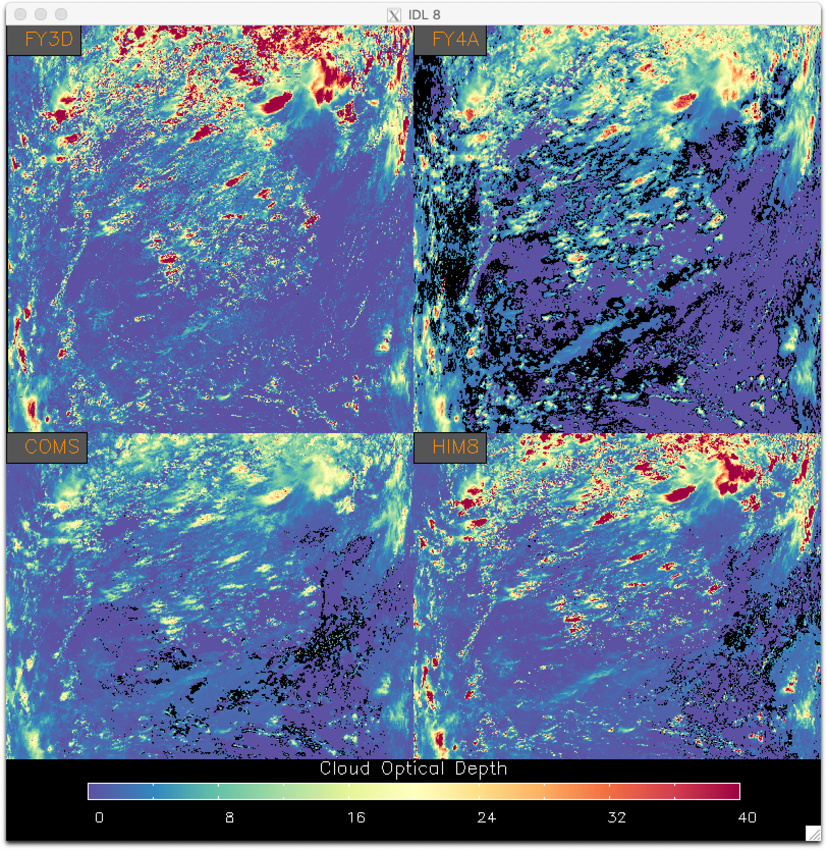
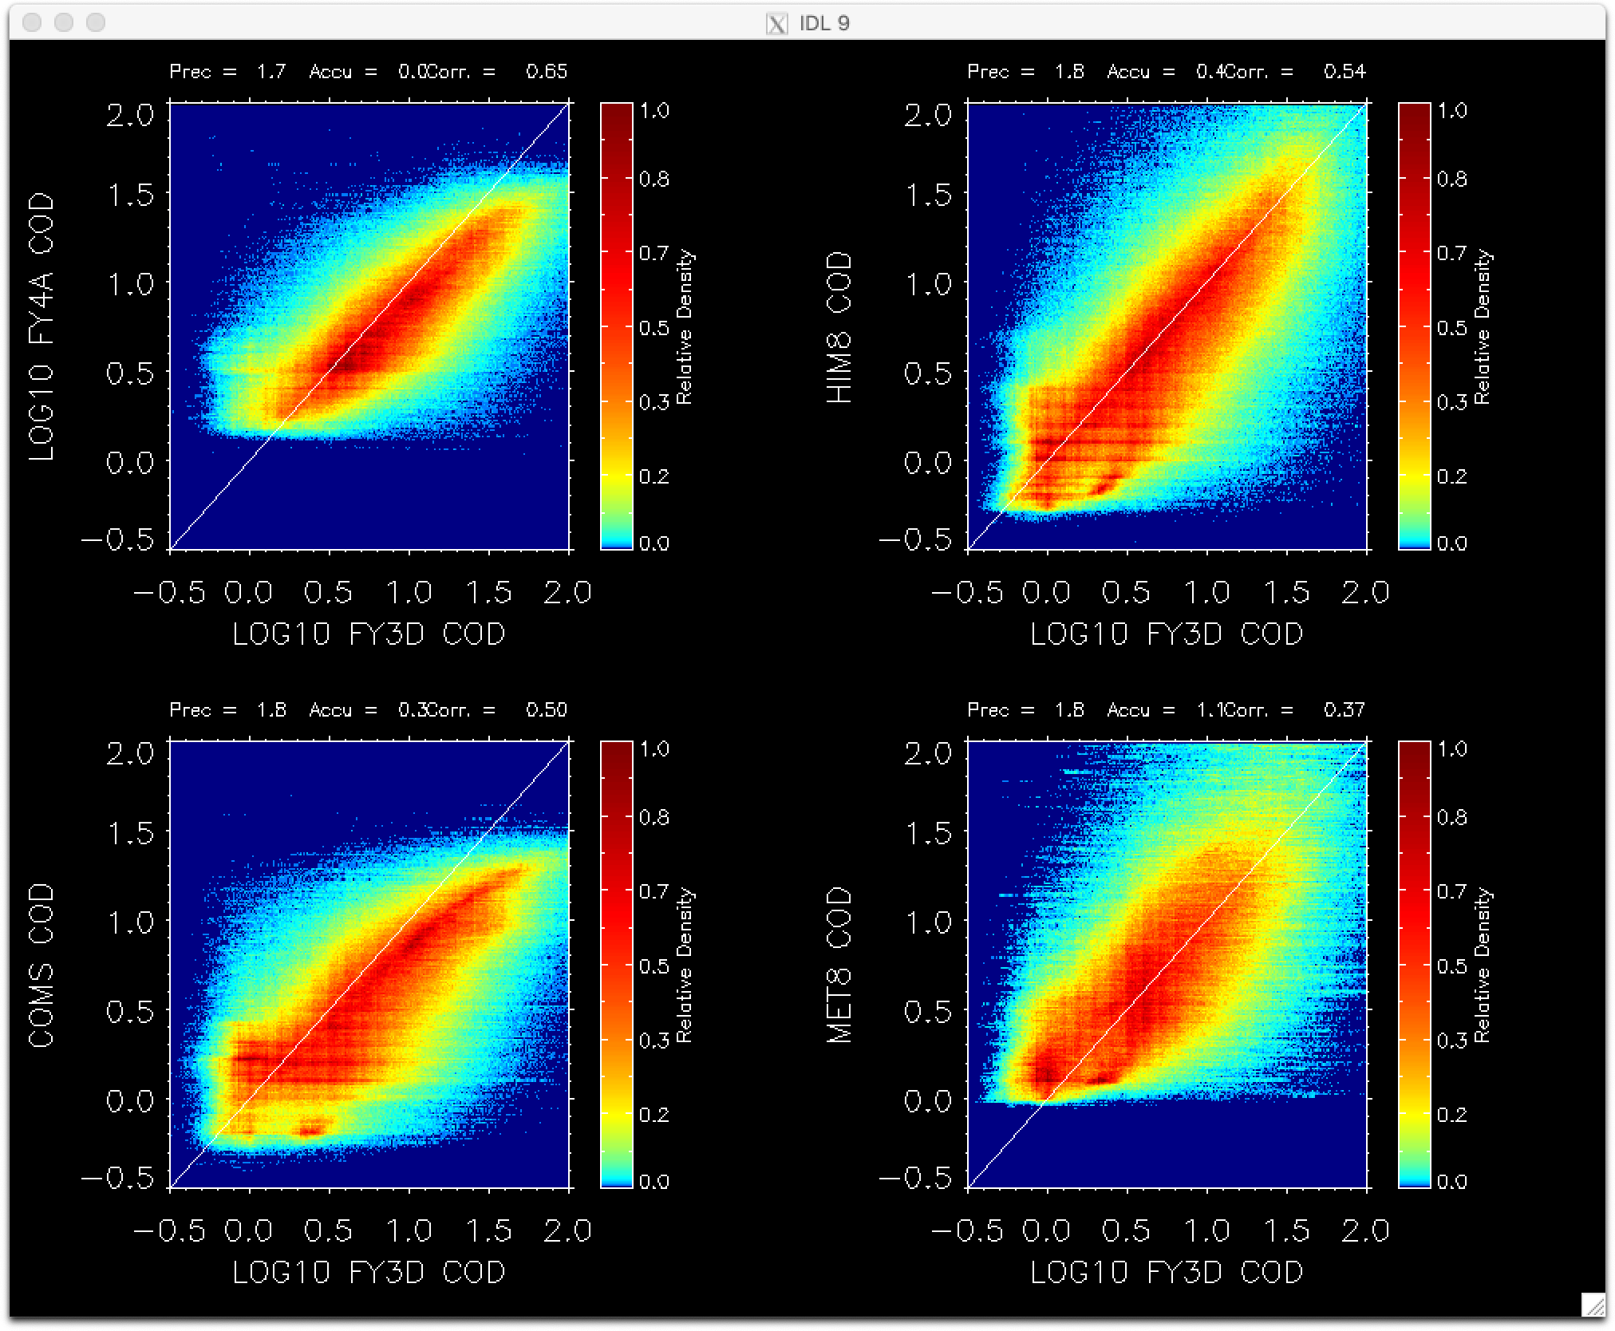
Comparison of Cloud Optical Depth
FY4A
HIM8
COMS
MET8
no data
Consistent with the Reflectance Comparison, COMS and FY4A COD values are less those from FY3D.
Black regions in the COD images show failed DCOMP retrievals.

Slide 31
Summary of FY3D Comparison to Asian Geo Imagers
FY3D BT11 values compared favorably to all Asian Geo Imagers analyzed.
FY3D 0.65 micron Reflectances agreed well with HIM8 but are brighter than those on COMS and FY4A.
Differences remain unexplained for the Cloud Type products and this impacts the agreement in the Cloud Top Pressure. When the cloud type agrees, the cloud top pressures agrees..
Cloud Optical Depth comparisons follow the pattern seen in 0.65 micron Reflectance comparisons.

Slide 32
Current CLAVR-x Development

Slide 33
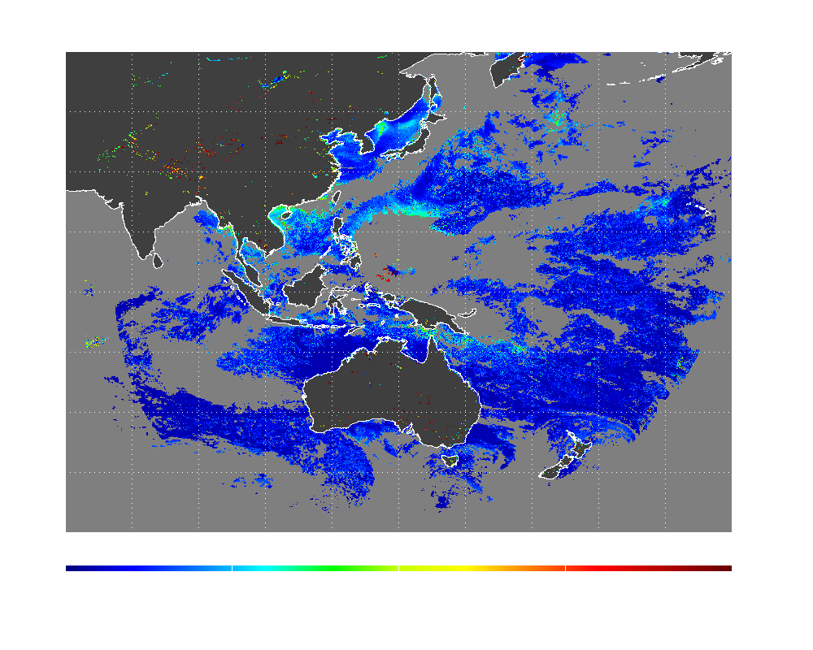
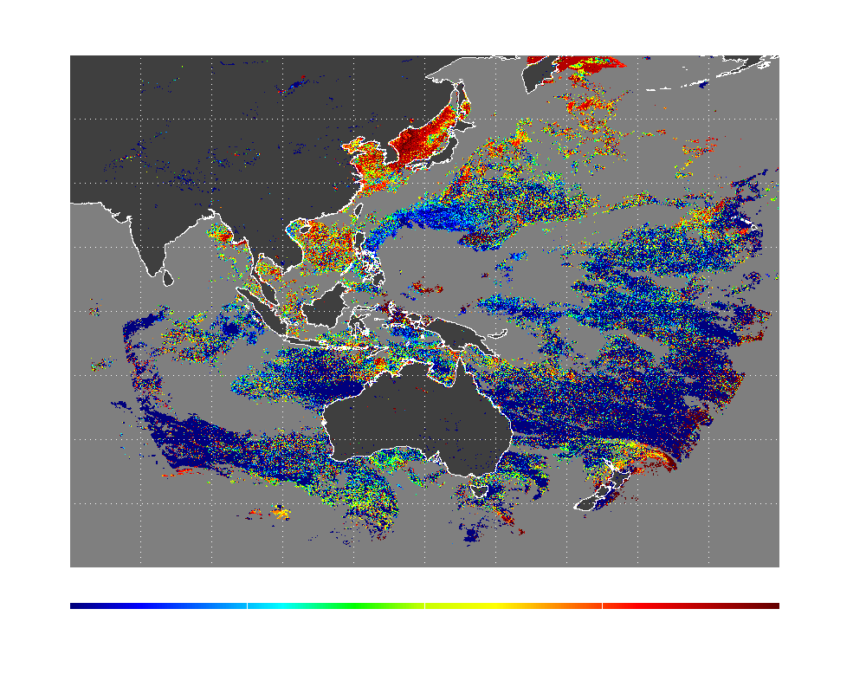
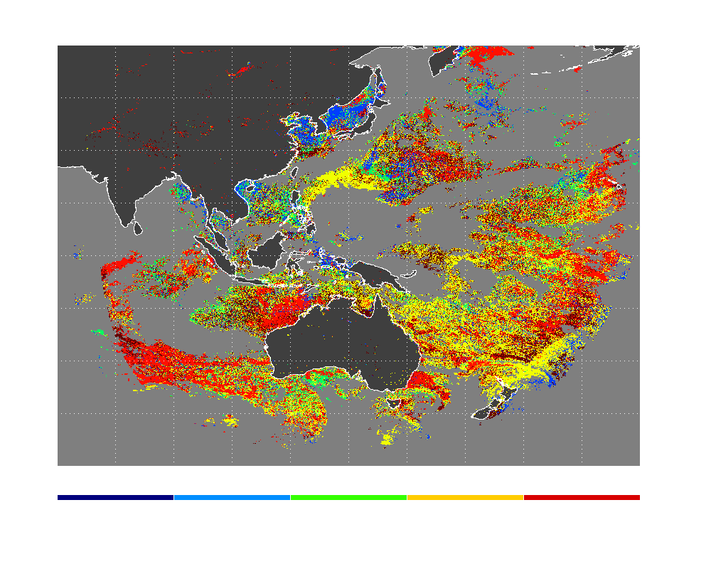
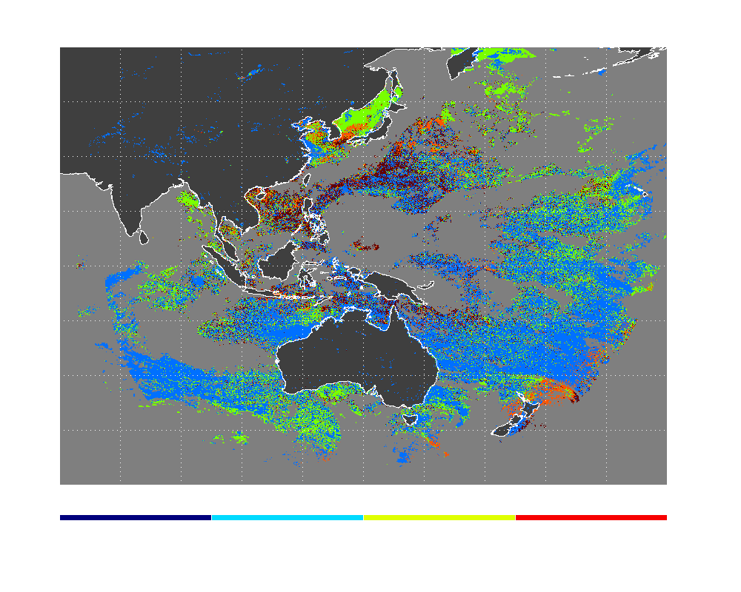
Implementation of AHI Aerosol Retrievals in CLAVR-x
Multidisciplinary Research Program of the University Research Initiative (MURI) program supports this project to develop an aerosol algorithm for littoral regions using the next generation geo-stationary observations (Advanced Himawari Imager (AHI) and GOES-R Advanced Baseline Imager (ABI) )
Responsible scientists and programmers at CIMSS: Min Oo , Robert Holz, Andi Walther
Dark Target (DT) approach over Ocean.
  The AHI dark target algorithm is modeled after the NASA MODIS aerosol retrieval
  We evaluate the geo-stationary retrial using collocated MODIS and VIIRS observations
The littoral aerosol retrieval adds considerable complexity due to the added uncertainty of the surface reflectance. AHI constant sensor view will help improving retrieval.

Slide 34
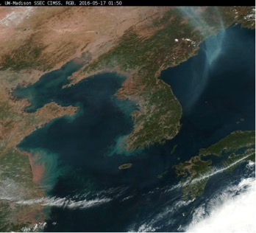
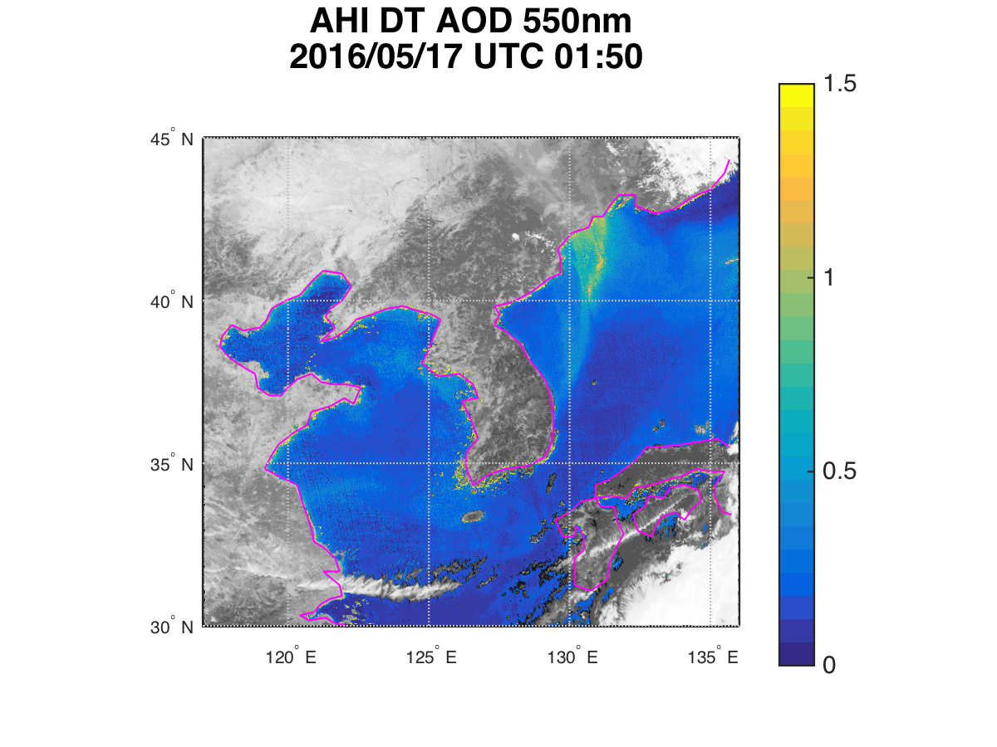
Coming soon: Adding over Land Retrieval
http://cimss.ssec.wisc.edu/korus-aq/
Notes:
Right now AOD is only Ocean, coming soon over Land

Slide 35
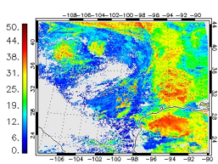
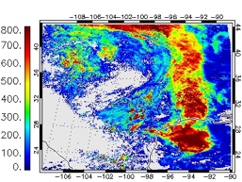
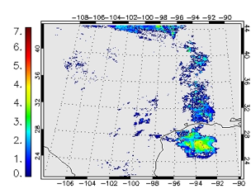
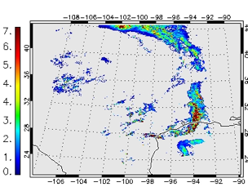
Rain Rate from CLAVR-x Cloud Products
Demonstration of the precipitation retrieval: (a) Cloud effective radius in micron, (b) Cloud water path in mm (c) the CLAVR-x rain detection and rate and (d) the NEXRAD precipitation rate for 18 April 2016, 18 UTC
Precipitation rate can be estimated from cloud properties such as water path, effective radius, cloud temperature, and cloud height.
Thresholds on water path and effective radius are used to detect rain.
Empirical coefficients are tuned against radar.
The images on the right show an example CLAVR-x VIIRS product created with default coefficients:

Slide 36
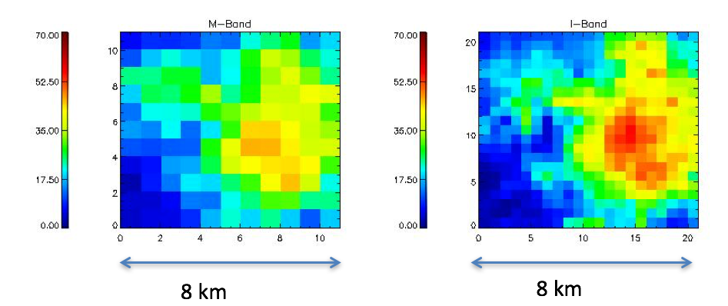
Use of Higher Spatial Resolution Information
MERSI-2 and other advanced imagers provided channels at different resolutions.
CLAVR-x nominally samples or averages all channels to the thermal channel resolution.
We are exploring using the higher resolution channels.
Example belows shows cloud optical depth from CLAVR-x/DCOMP/VIIRS for M-band (750m) and I-Band (375m)

Slide 37
How to Access CSPP LEO CLAVR-x
CSPP CLAVR-x can be easily obtained from CSPP CIMSS webpage: https://cimss.ssec.wisc.edu/cspp/
Right now available CSPP CLAVR-x version 2.0 (Poster by Nick Bearson).
Version 3.0 is currently undergoing testing:
  Supports MetOp-C.
  Option to save output in NetCDF4 format.
  User chooses output variables.
  Static navigation for Geo satellites.
Version 4.0 is expected to be released by January, 2020:
  It will support FY-3D and FY-4A.

Slide 38
Summary
New capability to support FY-3D and FY-4A cloud retrievals has been developed in CLAVR-x.
Comparisons to retrieval products from sensors onboard polar-orbiting and geostationary satellite are conducted.
After more rigorous testing, updates will be delivered to CSPP with an expected release date in early 2020.

Slide 39
Thank You Very Much!
Questions?

Slide 40
Backup Slides

Slide 41
Implementation Process within CLAVR-x
Determine channel mapping
Using SRFs determine planck, solar constants, DCOMP LUTs
Develop read routine and RTM functionality
Test L1b output
Develop sensor specific ECM LUT
(requires 1 year of collocated data with CALIOP)
Test L2 products with initial ECM LUT
Test and verify RTM output
Test and verify L1b output
Validate products
Notes:
Blue indicates future work. Very wishful thinking, but this is the process things should go, IMO

